Slide 1

Maps and Dictionaries
© 2013 Goodrich, Tamassia, Goldwasser
Maps and Dictionaries
Notes:
Dictionaries

Slide 2

Maps
A map is a searchable collection of items that are key-value pairs
The main operations of a map are for searching, inserting, and deleting items
Multiple items with the same key are not allowed
Applications:
  address book
  student-record database
© 2013 Goodrich, Tamassia, Goldwasser
Maps and Dictionaries

Slide 3
Dictionaries
Python’s dict class is arguably the most significant data structure in the language.
  It represents an abstraction known as a dictionary in which unique keys are mapped to associated values.
Here, we use the term “dictionary” when specifically discussing Python’s dict class, and the term “map” when discussing the more general notion of the abstract data type.
© 2013 Goodrich, Tamassia, Goldwasser
Maps and Dictionaries

Slide 4
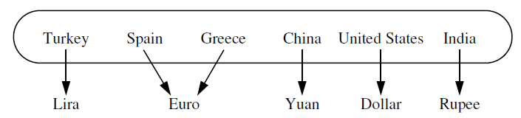
Examples
Natural language dictionary
  word is key
  element contains word, definition, pronunciation, etc.
Web pages
  URL is key
  html or other file is element
Any typical database (e.g. student record)
  has one or more search keys
  each key may require own organizational dictionary

Slide 5

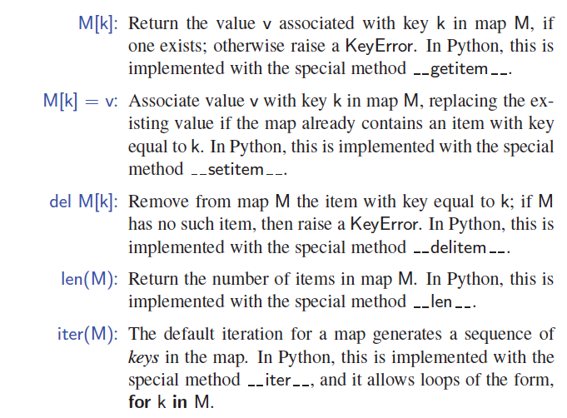
The Map ADT
(Using dict Syntax)
Get
Set
Delete
© 2013 Goodrich, Tamassia, Goldwasser
Maps and Dictionaries

Slide 6
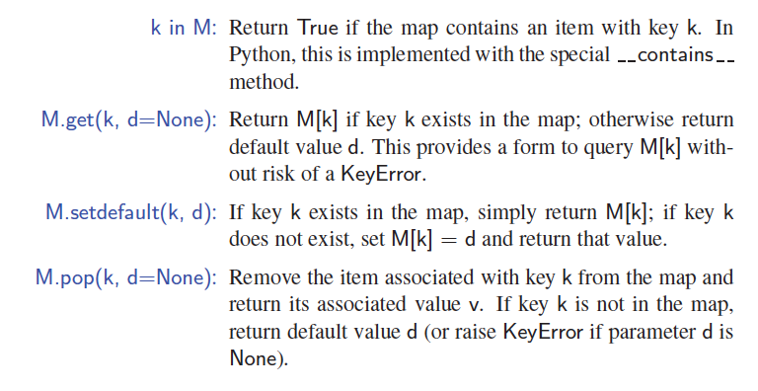
More Map Operations
contains
© 2013 Goodrich, Tamassia, Goldwasser
Maps and Dictionaries

Slide 7
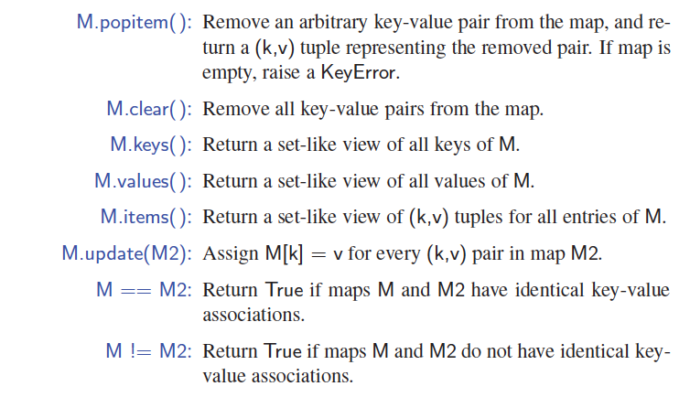
A Few More Map Operations
© 2013 Goodrich, Tamassia, Goldwasser
Maps and Dictionaries

Slide 8
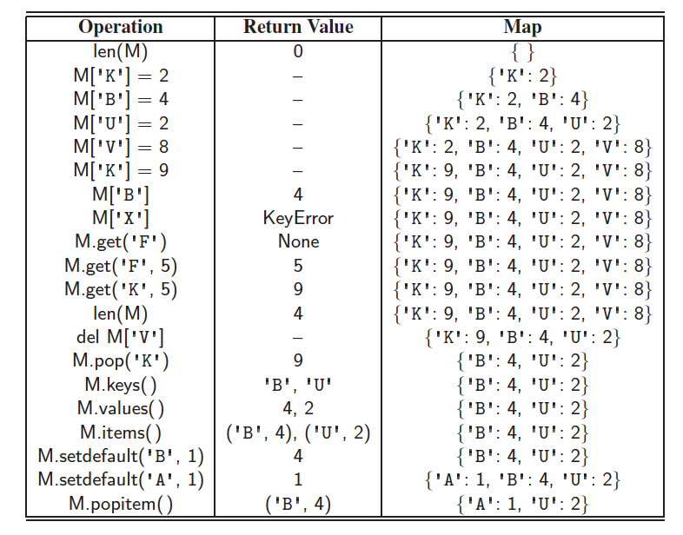
Example
© 2013 Goodrich, Tamassia, Goldwasser
Maps and Dictionaries

Slide 9
Coding: count word frequency
Consider the problem of counting the number of occurrences of words in a document.
Output the highest frequency word and number of times it appeared in the document.
Download word_frequency_students.py and inputtext2.txt file from Brightspace
Write your code in word_frequency_students.py file and submit to Gradescope
© 2013 Goodrich, Tamassia, Goldwasser
Maps and Dictionaries
Notes:
Dictionaries

Slide 10
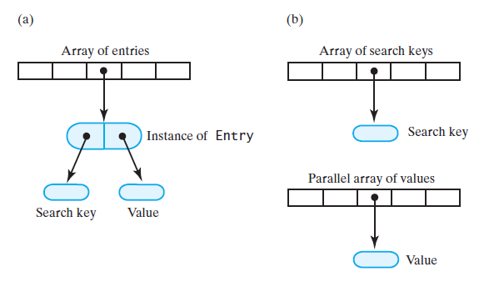
Array-Based Implementations
Store (key, value) as an Entry instance
Store (key, value) separately in arrays

Slide 11
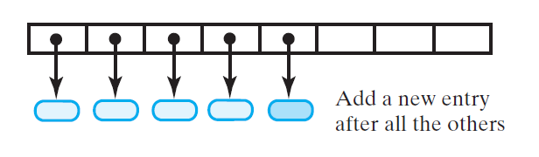
Array-Based – Entry Insertions
Unsorted implementation
Adding (key,value) requires searching if it already exists in map or not.
If exists, modify old value with new value
If not exists, append to the end

Slide 12
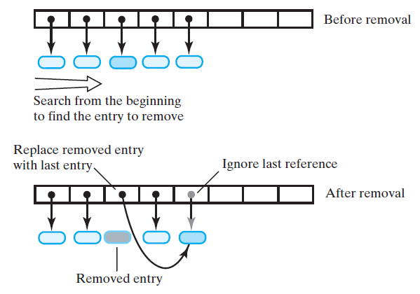
Array-Based – Entry Removals
Problem: empty index
Solution 1: Accept empty entries during traversal
Solution 2: Swap references

Slide 13
A Simple List-Based Map
We can implement a map using an unsorted list
  We store the items of the map in a list S (based on a doubly-linked list), in arbitrary order
header
nodes/positions
trailer
9
c
6
c
5
c
8
c
Items (key-value pairs)
© 2013 Goodrich, Tamassia, Goldwasser
Maps and Dictionaries

Slide 14
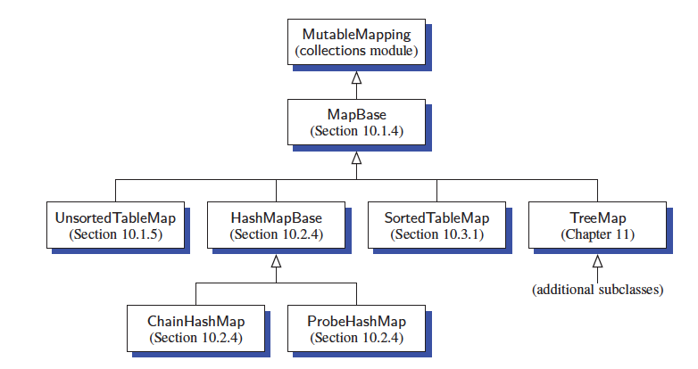
Our MapBase Class
(Key-Value) storage (insert/delete), and search
List, linear search
Hashtable
List, binary search
BST
© 2013 Goodrich, Tamassia, Goldwasser
Maps and Dictionaries

Slide 15
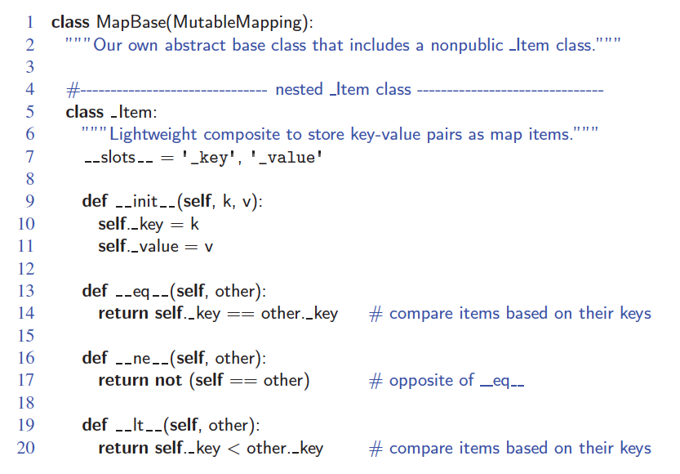
The MapBase Abstract Class
Define comparator ==, != , < so that we can compare two items x and y
© 2013 Goodrich, Tamassia, Goldwasser
Maps and Dictionaries
Notes:
_Item(‘james’, 18) < _Item(‘susan’, 25) returns True (since we use their keys to compare and order)
Dictionaries

Slide 16
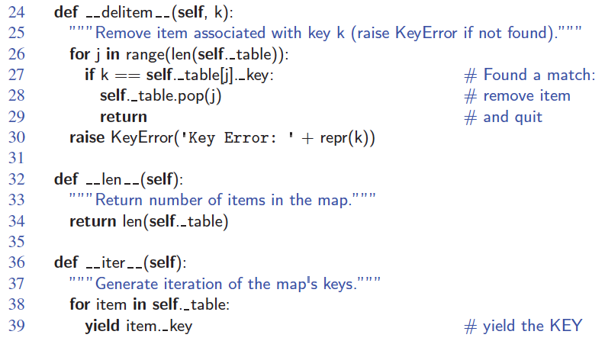
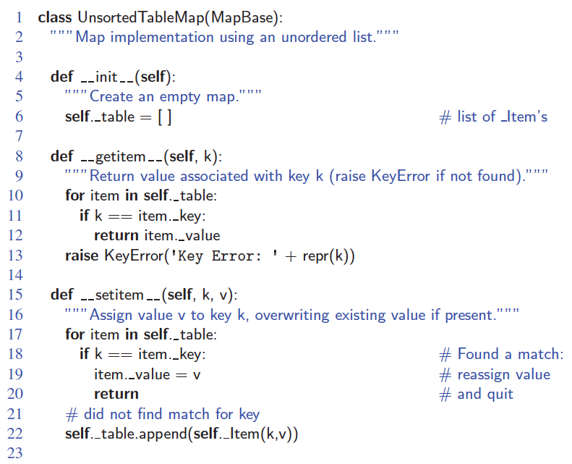
An Unsorted List Implementation
Get, Set, Del all take O(N) in the worst case, why?
© 2013 Goodrich, Tamassia, Goldwasser
Maps and Dictionaries

Slide 17
Performance of a List-Based Map
Performance:
  Inserting an item takes O(n) time due to search whether this item is new or already exists in map.
  Searching for or removing an item takes O(n) time, since in the worst case (the item is not found) we traverse the entire list to look for an item with the given key
© 2013 Goodrich, Tamassia, Goldwasser
Maps and Dictionaries

